Slide 1


Planning for Long-Term Care (LTC)

Slide 2
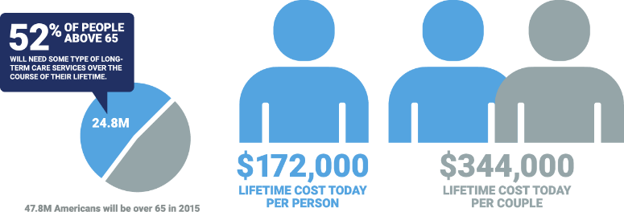
Long-Term Care is a Financial Issue
Health Insurance and Disability Insurance do not cover LTC
10% of LTC claims are covered by Medicare
        LTC insurance is 401K insurance.
Sources: https://www.pwc.com/us/en/industries/insurance/library/long-term-care-services.html, https://www.morningstar.com/articles/957487/must-know-statistics-about-long-term-care-2019-edition, longtermcare.gov, US Department of Health & Human Services,

Slide 3
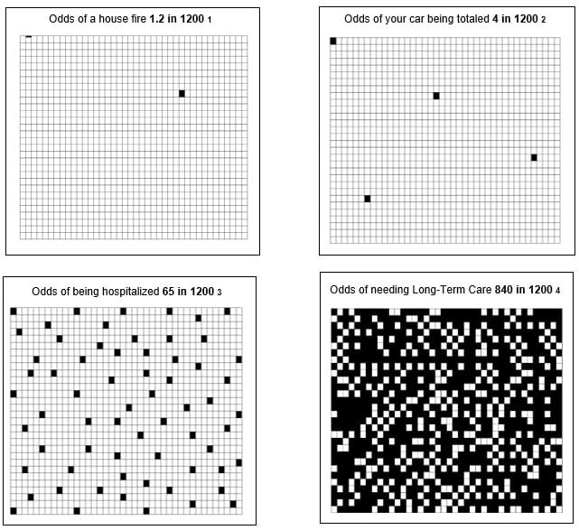
Odds of Needing Long-Term Care
Sources:
1 Fire Loss in the U.S., National Fire Protection Association® (NFPA®), 10/06/2022
2 CCC intelligent Solution, Inc, Crash-Course 2022 edition
3 Centers for Disease Control and Prevention, Summary Health Statistics for the U.S. Population, National Health Interview Survey, 2018
4 U.S. Department of Health and Human Services (HHS), Office of Disability, Aging and Long-Term Care Policy (DALTCP) and the Urban Institute. April 2017.

Slide 4


Long-Term Care is a Family Issue
Impact of LTC on families:
        83% OF CARE
        70%
        OF CAREGIVERS SUFFER WORK-RELATED DIFFICULTIES DUE TO THEIR CAREGIVING DUTIES
        PROVIDED TO OLDER ADULTS IS DELIVERED
        BY FRIENDS OR FAMILY MEMBERS
        20%
        OF FULL-TIME EMPLOYEES LOSE
        10+ HOURS PER WEEK DURING WORKING HOURS TO HELP AN
        AGING LOVED ONE
        By planning, you are reducing the caregiving burden on your family.
Source: https://www.morningstar.com/articles/957487/must-know-statistics-about-long-term-care-2019-edition

Slide 5
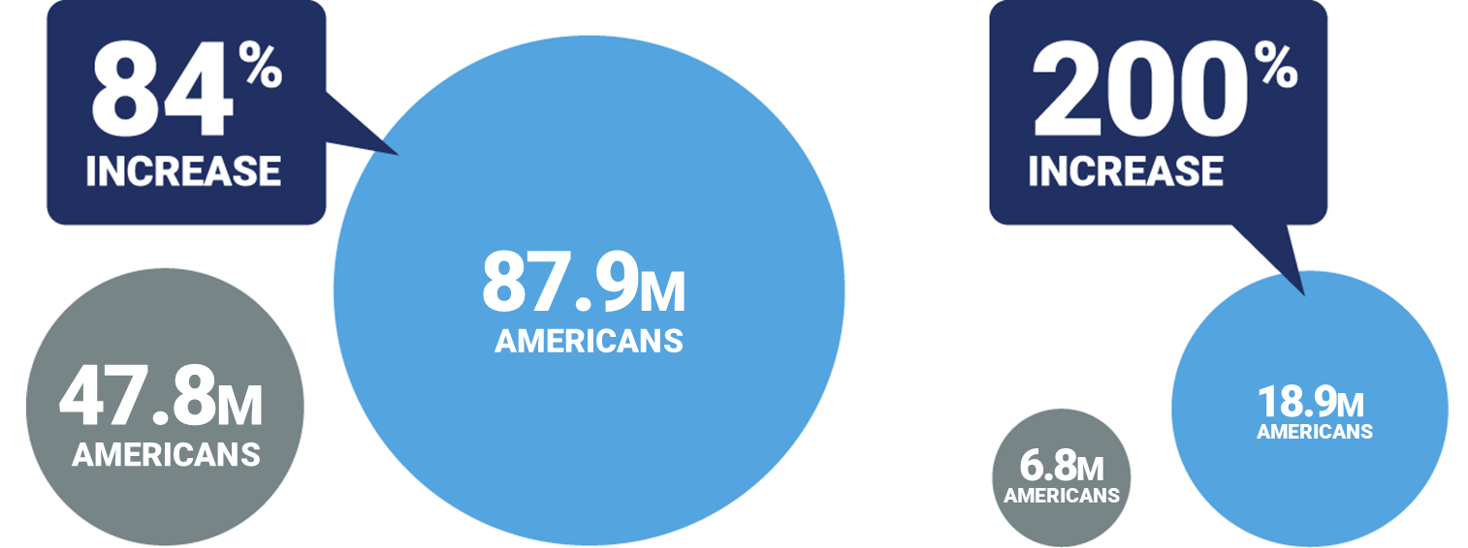
Long-Term Care is a Growing Issue
Americans are aging
OVER 65 in 2015
OVER 65 in 2050
OVER 85 in 2015
OVER 85 in 2050
Source: https://www.morningstar.com/articles/957487/must-know-statistics-about-long-term-care-2019-edition

Slide 6
Risks to Your Financial Future
Are you prepared for the potential financial risks and the future consequences that might happen down the line?
Unexpected Health Event
Outliving Your Income
Passing Away
Financially Unprepared

Slide 7
What is Long-Term Care (LTC)?
Personal care or supervision needed by persons of all ages for an extended period of time. LTC is associated with the effects of aging, but may be needed at any time, due to an accident or illness.
Some conditions that may require LTC:
  Head Injury
  Stroke
  Cancer
  Parkinson’s Disease
  Heart Disease
  Multiple Sclerosis
  Alzheimer’s Disease / Dementia

Slide 8
Who Will Need LTC?
1 out of every 5 people ages 65+ will need LTC for more than five years.*
In-Home
Care
Assisted
Living
Nursing
Home
* Long-Term Services and Supports for Older Americans: Risks and Financing Research Brief, Judith Dey, August 2022.

Slide 9
The Cost of a Private Nursing Home Room Across the U.S.
WA
WA
MT
MT
ND
ME
ME
OR
ND
VT
OR
MN
NH
VT
ID
SD
MN
WI
NY
MA
NH
ID
WY
MI
CT
NY
RI
SD
WI
MI
PA
CT
NV
WY
NE
IA
NJ
UT
OH
PA
DE
IA
IL
IN
MD
NV
CO
NE
WV
OH
NJ
CA
UT
KS
MO
KY
IN
VA
DC
CO
IL
$91,000
TN
NC
WV
CA
KS
MO
VA
AZ
NM
OK
AR
KY
SC
GA
NC
$15,600
MS
AL
TN
AZ
NM
TX
OK
LA
AR
SC
Annual Average
MS
FL
GA
$175,000 – $365,000
TX
LA
$155,000 – $175,000
AK
$135,000 – $155,000
HI
FL
$115,000 – $135,000
$95,000 – $115,000
AK
$85,000 – $95,000
Source: CareScout® Cost of Care Survey, July through December 2024. Based on cost of 365 days of care for a private room in a nursing home.
HI

Slide 10
The Home Care Costs of LTC Across the U.S.
WA
WA
MT
MT
ND
ME
ME
OR
ND
VT
OR
MN
NH
VT
ID
SD
MN
NY
MA
NH
ID
WY
WI
MI
CT
RI
SD
WI
MI
NY
WY
IA
PA
CT
NV
NE
OH
NJ
DE
UT
IA
IL
IN
PA
MD
NV
CO
NE
WV
OH
NJ
CA
UT
KS
MO
KY
IN
VA
DC
CO
IL
$91,000
TN
NC
WV
CA
KS
MO
VA
AZ
NM
OK
AR
KY
SC
GA
TN
NC
$15,600
MS
AL
Annual Average
AZ
NM
TX
OK
LA
AR
SC
$100,000 – $110,000
MS
FL
GA
$90,000 – $100,000
TX
LA
$80,000 – $90,000
AK
$70,000 – $80,000
HI
FL
$60,000 – $70,000
$50,000 – $60,000
AK
Source: CareScout® Cost of Care Survey, July through December 2024. Based on cost of 44 hours per week by 52 weeks for a home health aide to provide in-home care.
HI

Slide 11
Paying for LTC
Who pays for LTC? Will medical insurance cover it?
It’s a common misconception that Medicare or Medicaid will cover all expenses. The truth is you’ll need to be able to cover much of the costs yourself in the form of either cash or private insurance.
 | Medicare | Private Medigap Insurance | Medicaid | You Pay on Your Own
Nursing Home Care | Days 0 – 20: Pays in full if you’re hospitalized for at least three consecutive days before entering a Medicare-approved skilled nursing facility. Days 21 – 100: May pay for the difference between the total daily cost and a significant copayment if you continue to need skilled nursing care. Days 100+: Does not pay | Days 21 – 80: May cover a significant copayment if your nursing home stay meets all other Medicare requirements | Medicaid will pay for nursing home care. However, most individuals will not qualify for Medicaid in most states unless he or she has less than $2,000 in countable assets | If you need only personal or supervisory care in a nursing home and/or have not had a prior hospital stay, or if you choose a nursing home that does not participate in Medicaid or is not Medicare certified. Also, if you need care beyond the 100 days Medicare is willing to pay
Assisted Living Facility (and similar facility options) | Does not pay | Does not pay | In some states, may pay care-related costs, but not room and board | You pay on your own except as noted under Medicaid, if eligible
Continuing Care Retirement Community | Does not pay | Does not pay | Does not pay | You pay on your own
Adult Day Services | Not covered | Not covered | Varies by state, financial and functional eligibility required | You pay on your own except as noted under Medicaid, if eligible
Home Health Care | Limited to reasonable, necessary part-time or intermittent skilled nursing care and home health aide services, and some therapies that are ordered by your doctor and provided by Medicare-certified home health agency. Does not pay for ongoing personal care or custodial care needs (help) with activities of daily living | Not covered | Pays for, but states have option to limit some services, such as therapy | You pay on your own for personal or custodial care, except as noted under Medicaid, if eligible
Source: LongTermCare.gov (Medicare and Medicaid), 2020

Slide 12
Why Plan “NOW” for LTC?
LTC Insurance planning = nursing home avoidance coverage (plans pay for home healthcare)
Healthcare (acute & long-term) is “front-of-mind” for most Americans today
Record low interest rates -- carriers will likely continue to re-price products (increase rates for new applicants or modify interest rate assumptions)
Underwriting changes – we’re all learning more about Covid-19 & as we learn more, carriers may modify their guidelines or offers
During down market swings or recessions, people tend to want “protection products” vs. self-insuring against this risk
Complimentary piece to a Financial Wellness or Retirement Readiness program
Alternative to publicly funded LTC programs (taxpayer-sponsored)

Slide 13
Important LTC Questions
Where are the LTC services provided?
What effect could LTC have on my family and retirement strategy?
What could LTC cost?
What are my options if I need to pay for LTC?
Notes:
Each year, LIMRA comes out with a research report called the Insurance Barometer. As it sounds, the report gauges consumer sentiments.
Here’s our BIG challenge. It’s bigger than us, I mean in the financial services or insurance industry.
This is BIG social issue or challenge.
Check out the disconnect here.
How do we change our clients & prospects behavior?

Slide 14
Risk Management and LTC
You take protective measures in other aspects of life. LTC should be
no exception.
Why not help protect the retirement lifestyle you have worked your entire life to create?
Wellness
Transportation
Family and Wealth
Home
Retirement
Life & Disability Insurance
LTC
Insurance
Health
Insurance
Auto
Insurance
Homeowner’s
Insurance
✔
✔
✔
✔
?

Slide 15
LTC Planning
LTC Planning: A Three-Step Process
Living a long life is a near certainty in this day and age. Planning for it is a necessity.
1
Understand
2
Develop
3
Implement
Understand the Need
or Risk
Personal experiences
Consequences of living a long life
Develop a Strategy to Offset the Risk
LTC is a family issue
There is risk to the family if there is no strategy
Develop a strategy
Implement the Strategy
LTC insurance planning
Self-funding
Caregiving plan
Ownership Structure
Notes:
Keeping choices as simple as possible. As an advisor, you may think your job is to give a possible buyer multiple options for planning for care, such as spread sheeting several insurance carriers or comparing standalone and linked products. However, the reality is consumers don't want this - they want a recommendation with just a few choices. Limit the options they can consider.
Focus on the possible gain LTC will provide instead of the possible loss. Gamblers fell worse about losses than good about wins. Likewise, people who are considering LTC Insurance don't want to think about loss when planning for care, such as how their retirement savings may be depleted. Instead, try and focus on the fact that a small LTC Insurance premium gives the policyholder the possibility of a BIG payoff in benefits. For example, a $2,000 annual premium could result in $300,000 to pay for high-quality care ah at home.
Use stories, not statistics! Statistics are important for discovering trends and insights, but they are awful when used for discussing LTC planning. Statistics destroy empathy and emotion. People are way too optimistic about their future and think they will be on the winning side of a statistic. Focus on stories and experience when talking about planning for LTC.
Focus on now benefits, not the future. It's incredibly hard for people to imagine aging and needing help. Only something like an aging suit can really give people a glimpse of how needing care will affect them and their families. Instead, focus on the "now" benefits of LTC Insurance. The now benefits for LTC Insurance are harder to quantify, but they can include peace of mind, good health underwriting, and locking into a lower premium before a birthday.
Help Guide Heuristics (rules of thumb). For analytical advisors, it's tempting to use tools such as cost of care surveys that project the cost of care 40 years in the future when designing plans. A better approach is to "follow the crowd" and recommend benefits similar to what policyholders are actually buying. You may think that people want customized solutions, but most would feel more comfortable picking options similar to other buyers. Recommend they do what most people are doing.
Force a choice. When people have to make a decision, such as actively signing off the fact they have been offered LTC insurance but declined, they will be more likely to buy. LTC planning is easy to delay, and people don't want to be told they can't delay that decision forever

Slide 16
How LTC Insurance Works
LTC provides a “pool of benefit dollars” for LTC to be used when and where it may be needed.
Assisted
Living Care
Home
Care
Care
Coordination
Services
Nursing
Facility Care
Notes:
Keeping choices as simple as possible. As an advisor, you may think your job is to give a possible buyer multiple options for planning for care, such as spread sheeting several insurance carriers or comparing standalone and linked products. However, the reality is consumers don't want this - they want a recommendation with just a few choices. Limit the options they can consider.
Focus on the possible gain LTC will provide instead of the possible loss. Gamblers fell worse about losses than good about wins. Likewise, people who are considering LTC Insurance don't want to think about loss when planning for care, such as how their retirement savings may be depleted. Instead, try and focus on the fact that a small LTC Insurance premium gives the policyholder the possibility of a BIG payoff in benefits. For example, a $2,000 annual premium could result in $300,000 to pay for high-quality care ah at home.
Use stories, not statistics! Statistics are important for discovering trends and insights, but they are awful when used for discussing LTC planning. Statistics destroy empathy and emotion. People are way too optimistic about their future and think they will be on the winning side of a statistic. Focus on stories and experience when talking about planning for LTC.
Focus on now benefits, not the future. It's incredibly hard for people to imagine aging and needing help. Only something like an aging suit can really give people a glimpse of how needing care will affect them and their families. Instead, focus on the "now" benefits of LTC Insurance. The now benefits for LTC Insurance are harder to quantify, but they can include peace of mind, good health underwriting, and locking into a lower premium before a birthday.
Help Guide Heuristics (rules of thumb). For analytical advisors, it's tempting to use tools such as cost of care surveys that project the cost of care 40 years in the future when designing plans. A better approach is to "follow the crowd" and recommend benefits similar to what policyholders are actually buying. You may think that people want customized solutions, but most would feel more comfortable picking options similar to other buyers. Recommend they do what most people are doing.
Force a choice. When people have to make a decision, such as actively signing off the fact they have been offered LTC insurance but declined, they will be more likely to buy. LTC planning is easy to delay, and people don't want to be told they can't delay that decision forever

Slide 17
A Comparative Glance at Preparing for LTC
LTC Insurance
Life / LTC Hybrid
Life Insurance with Riders
Fixed or Indexed Annuities
Help protect your clients’ assets from costs incurred due to LTC and/or healthcare needs.
Help protect your clients’ assets from costs incurred due to LTC care and/or home healthcare needs while retaining
maximum flexibility.
Maximizes the death benefit while retaining moderate flexibility.
LTC options late in life for those with potential health concerns.
What is it?
Inflation Protection
Care coordination benefit (“concierge healthcare”)
Tax deductible for business owners
Benefit usually not taxable
Standardized benefit trigger
Increases flexibility and provides benefits for an LTC event
Flexible payment options
Return of premium options (may be taxable)
Guaranteed premiums
Includes both life and LTC benefits
Potentially larger death benefits
Comparatively low premium cost for rider
Better suited to pay for benefits on a monthly basis, if needed
Limited or no medical underwriting
1035 exchange of existing annuity could turn tax-deferred growth into tax-free LTC payments
Benefits
Premiums may not
be guaranteed
“Use it or lose it” premium
(no cash value or return
on premium)
Opportunity cost (if single premium option is selected)
Not the same tax advantages for business owners
Generally costs more than traditional LTC
If LTC is needed, reduction of death benefit
Typically no return of premium
Benefit triggers not standardized
Benefits typically determined at claim time
No inflation protection
Benefit may be taxable
Limited or no inflation protection
Typically no care coordination
No tax advantages for business owners
Benefit may be taxable
Considerations
Notes:
Keeping choices as simple as possible. As an advisor, you may think your job is to give a possible buyer multiple options for planning for care, such as spread sheeting several insurance carriers or comparing standalone and linked products. However, the reality is consumers don't want this - they want a recommendation with just a few choices. Limit the options they can consider.
Focus on the possible gain LTC will provide instead of the possible loss. Gamblers fell worse about losses than good about wins. Likewise, people who are considering LTC Insurance don't want to think about loss when planning for care, such as how their retirement savings may be depleted. Instead, try and focus on the fact that a small LTC Insurance premium gives the policyholder the possibility of a BIG payoff in benefits. For example, a $2,000 annual premium could result in $300,000 to pay for high-quality care ah at home.
Use stories, not statistics! Statistics are important for discovering trends and insights, but they are awful when used for discussing LTC planning. Statistics destroy empathy and emotion. People are way too optimistic about their future and think they will be on the winning side of a statistic. Focus on stories and experience when talking about planning for LTC.
Focus on now benefits, not the future. It's incredibly hard for people to imagine aging and needing help. Only something like an aging suit can really give people a glimpse of how needing care will affect them and their families. Instead, focus on the "now" benefits of LTC Insurance. The now benefits for LTC Insurance are harder to quantify, but they can include peace of mind, good health underwriting, and locking into a lower premium before a birthday.
Help Guide Heuristics (rules of thumb). For analytical advisors, it's tempting to use tools such as cost of care surveys that project the cost of care 40 years in the future when designing plans. A better approach is to "follow the crowd" and recommend benefits similar to what policyholders are actually buying. You may think that people want customized solutions, but most would feel more comfortable picking options similar to other buyers. Recommend they do what most people are doing.
Force a choice. When people have to make a decision, such as actively signing off the fact they have been offered LTC insurance but declined, they will be more likely to buy. LTC planning is easy to delay, and people don't want to be told they can't delay that decision forever

Slide 18
Next Steps
Take the time now to plan for your long-term needs.
Contact me today to learn more.

