Slide 1


LONG-TERM CARE
2014 Case Study

Slide 2
Client Background
University with 19,000 employees
2001
Installed 1st LTC program as part of a state offering
2006
2nd LTC program implemented as a standalone program
March 2012
LTC carrier ceased offering program to new entrants
Spring 2013
November 2013
Client conducted annual benefit survey and Long-Term Care was rated among the top requested benefits
Request for Proposal completed
April
2014
New LTC program effective and open enrollment

Slide 3
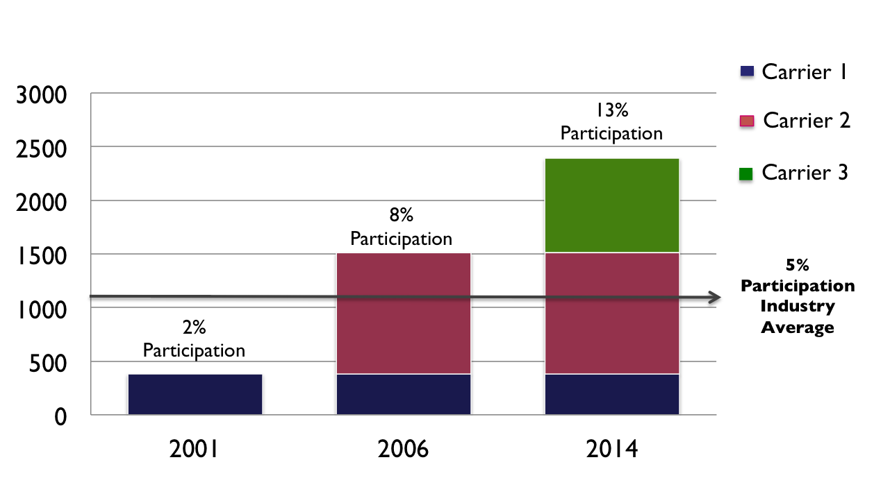
Participation Experience
Number of Insureds
On-going enrollment center support for new hires

Slide 4
Enrollment Results
Total Submitted Online Applications: 880 applications – 19 declined (2%)
- Enrollment Timing: | Off-Cycle
- Enrollment Period: | 3 weeks plus 1 week extension
- Underwriting Type (Employee): | Simplified underwriting for actively-at-work employees
- Underwriting Type (Spouse/Family): | Full underwriting
- Inbound Calls to Enrollment Center: | Over 2,100
- Inbound Email Inquiries: | Over 500
- Group Meetings: | 16 (included webinar broadcast)
- Virtual Consultation Requests: | Over 1,800
- LTC Educational Video Views: | 4,650
- Email Communication: | 8 educational emails over 4 weeks
- Email Open Rate: | Over 92% (only 11 recipients unsubscribed)

Slide 5
Sales and Enrollment Support
Provide education and collateral materials that can be used to introduce LTC planning concepts
Conduct discovery meeting and demographic analysis for each client
Create customized plan design options for each client based on their demographics
Perform LTC marketing and evaluate all carrier proposals
Present marketing results and develop an implementation timeline
Manage all aspects of the implementation (enrollment meetings and webinars, call center support, application assistance, policy delivery etc.)
Provide ongoing service (re-enrollments, product or industry changes etc.)
(877) 949-4582 ext. 7
GroupLTC@LTCIPartners.com

